Slide 1
Hénon-Heiles Hamiltonian – Chaos In 2-D Modeling Chaos & Complexity – 2008 Youval Dar UCD Physics Dept. dar@physics.ucdavis.edu
Abstract
Chaos in two degrees of freedom (4 coordinates), demonstrated by using the Hénon-Heiles Hamiltonian

Slide 2
Introduction
In 1964, Michael Hénon and Carl Heiles were investigating the motion of a star around a galactic center
Hamiltonian equations – typical physical problem
We have energy conservation, so we do not want the phase space to contract
Interesting dynamic with chaotic and non-chaotic regions

Slide 3
Introduction continued
The Hamiltonian governing this motion will have three degrees of freedom (6 coordinates in phase space)
Hénon and Heiles wanted to simplify the problem
Energy conservation
Angular momentum conservation (due to the cylindrical symmetry)
Observation, motion is confined into two dimensions
Chose to use a near elliptic motion Hamiltonian
Poincaré plots – as a tool to investigate dynamics

Slide 4
The Hamiltonian

Slide 5
Basic Analysis
Fixed Points

Slide 6
Sums to zero, can be only real or only imaginary
Using the energy conservation
For x = 0 Det(J) = 1 only for y = 0
For y = -1/2 |Det(J)|=1 for x = 0.25
Alarming since I expected the Det(J) to be 1 all the time

Slide 7
The Potential
The extremum points I found were
Looking at the dynamics of the system using Poincaré, instead of LCE.
Show The Mathematica Potential plots
3D Python
Poincaré - Python

Slide 8
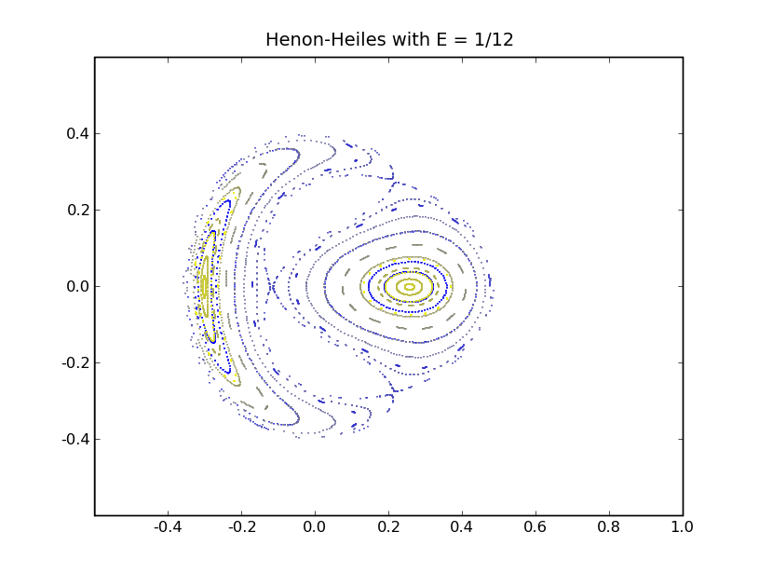

Slide 9
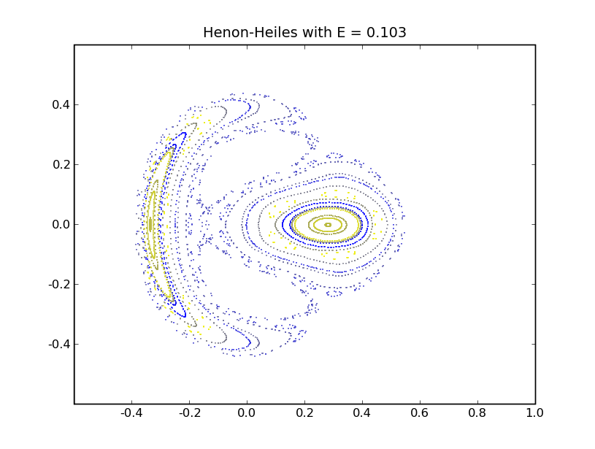

Slide 10
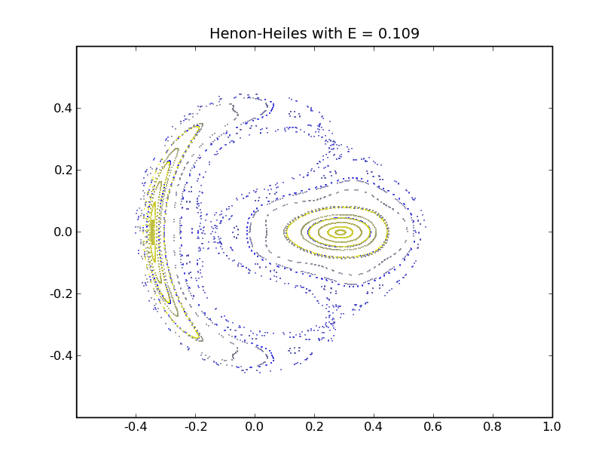

Slide 11
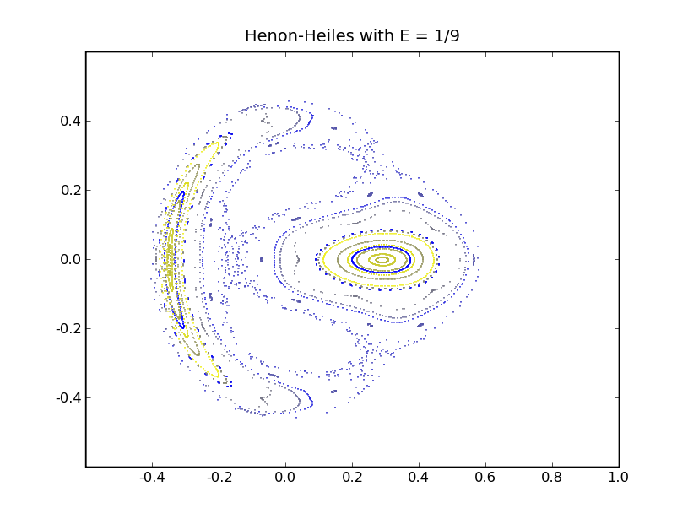

Slide 12
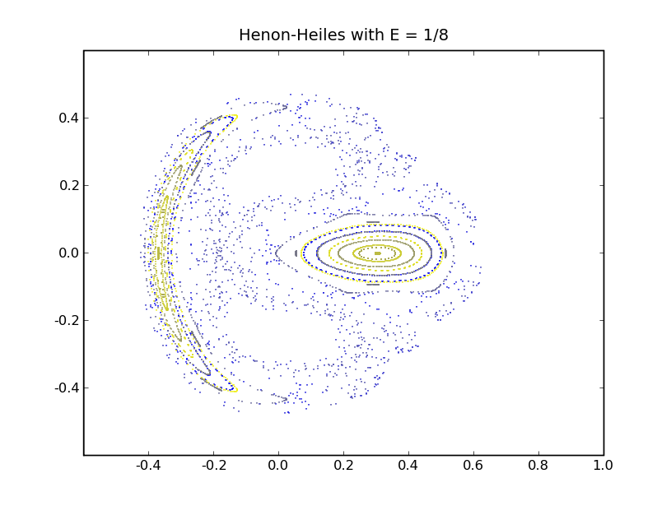
Poincaré interpretation
In the potential whale we can get both some regular orbit and chaotic once
As we get closer to the saddle points line the percent of the chaotic region in phase space increases
At the edges of the region we get elliptic orbits
Chaos onset – around 1/9

Slide 13
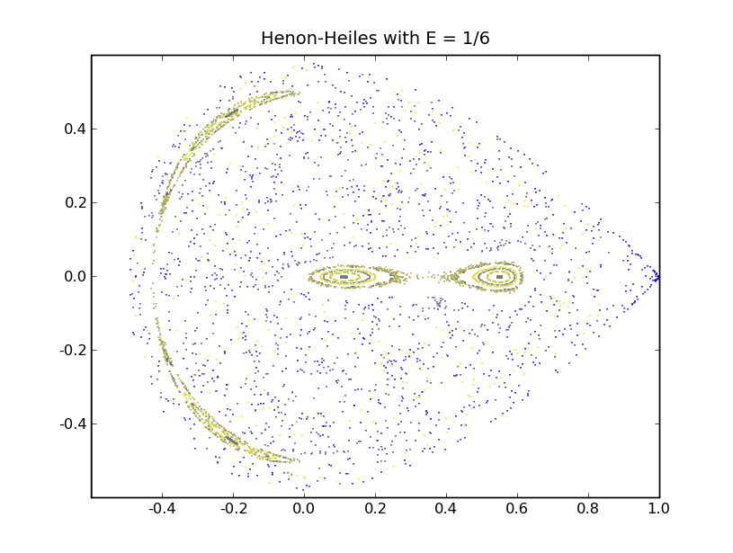

Slide 14
More questions
Going back to the original star motion problem, it would be interesting to know if stars are found in some typical energy or region of the phase space, and to make some Y vs. X plots
Lyapunov Exponents analysis
Exploring more initial conditions
Use a different plane for the Poincaré plot
Improve program’s user interface, intersection plane

