Slide 1
Complexity and Memory in Animal Movement
Alexander Vining
Animal Behavior Graduate Group, UC Davis

Slide 2
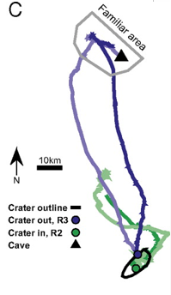
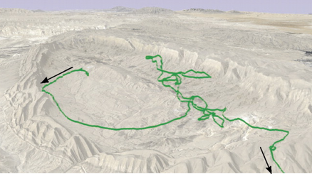
The Egyptian Fruit Bat Finds Home
Bat World Sanctuary
Asaf Tsoar et al. PNAS 2011;108:E718-E724
Notes:
Fruit bats live in caves
Flies straight from cave to the same fruit trees night after night

Slide 3
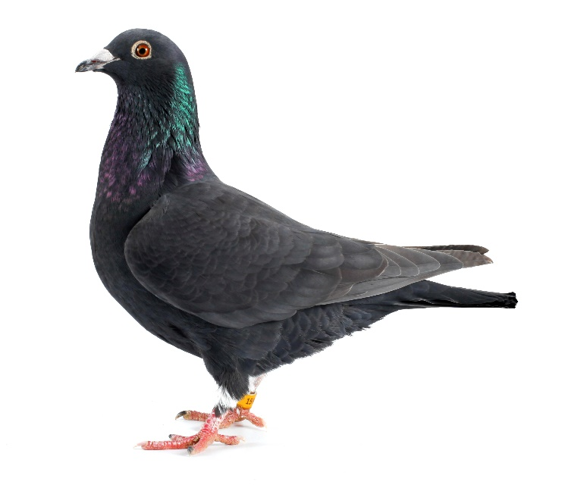
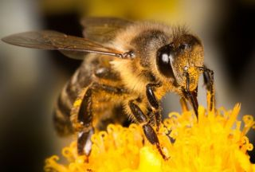
Many Animals Remember Where Home Is
Notes:
We use different strategies to navigate!
Lottia Scabra
Apis Melifera
Columba livia domestica

Slide 4
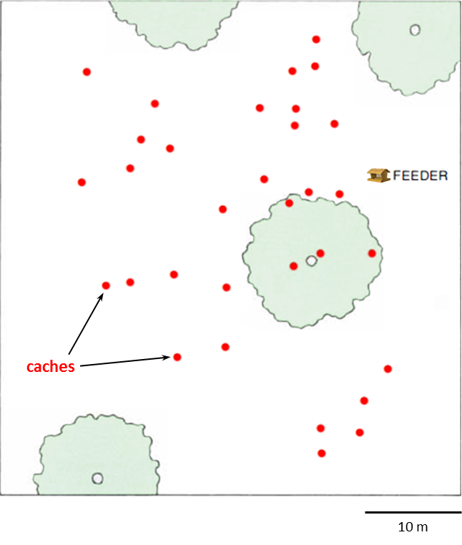
Some Animals Remember Many Locations
Aronov Lab - https://www.aronovlab.com/birds/

Slide 5
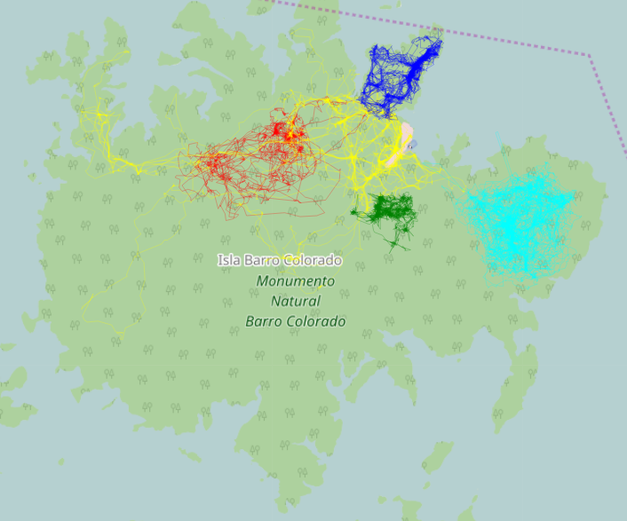
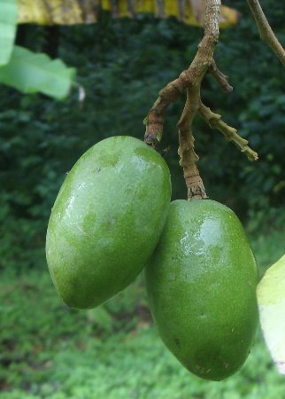
The Frugivorous Mammals of Barro Colorado
Notes:
Capuchin – Cebus Apella - Ibeth
Spider Monkey – Ateles Geoffroyi - Chibi
White nosed coati – Nasua Narica - Atlas
Kinkajou – Potos flavus - Chloe
Paca -Cuniculus paca
Collared Peccary - Pecari tajacu - Merk
Dipteryx odorata

Slide 6
Analyzing the GPS Data
discrete-time, continuous space
Build a maximally predictive model
OPTION 1: Convert to continuous time, discrete space

Slide 7
Building a maximally predictive model
Partition Space
Model region transitions as a renewal process
Build a Semi-Markov ϵ-machine
Find Hidden (Memory) States

Slide 8
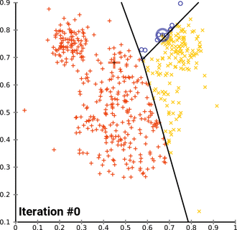
Partitioning Space
k-means algorithm
Wikipedia
Notes:
Find number of points (k) that minimize the within-cluster sum of squares
Assigns, calculates centroid, reassigns to new nearest centroid

Slide 9
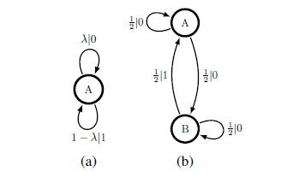
Region Transitions as a Renewal Process
Stationary Renewal Processes
Marzen & Crutchfield (2015). Entropy, 17, 4891-4917; doi:10.3390/e17074891
Poisson
Simple
Non-Unifilar Source

Slide 10
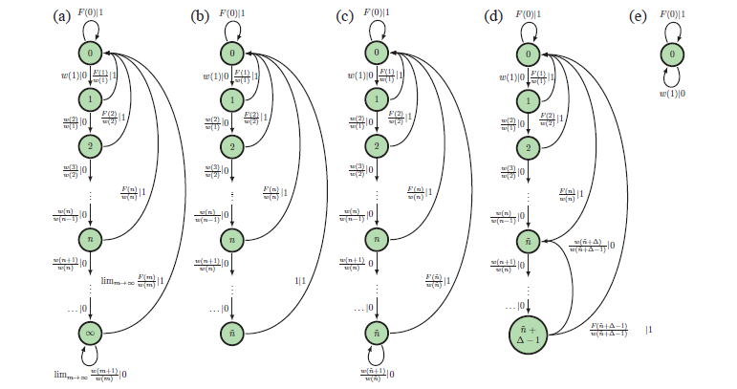
Region Transitions as a Renewal Process
Stationary Renewal Processes
Marzen & Crutchfield (2015). Entropy, 17, 4891-4917; doi:10.3390/e17074891
Notes:
Figure 3. -Machine architectures for discrete-time stationary renewal processes: (a) not
eventually -Poisson with unbounded-support interevent distribution; (b) not eventually
-Poisson with bounded-support interevent distribution; (c) eventually -Poisson with
characteristic (~n; = 1) in Definition 2; (d) eventually -Poisson with characteristic
(~n; > 1) in Definition 2; (e) for comparison, a Poisson process -machine.

Slide 11
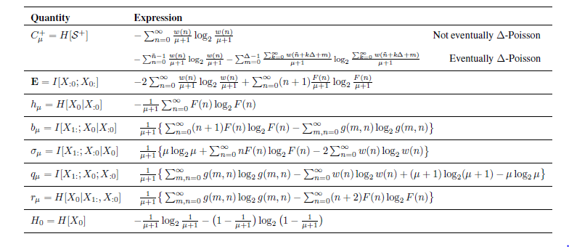
Region Transitions as a Renewal Process
Stationary Renewal Processes
Complexity in animal residence times
Marzen & Crutchfield (2015). Entropy, 17, 4891-4917; doi:10.3390/e17074891
Notes:
Figure 3. -Machine architectures for discrete-time stationary renewal processes: (a) not
eventually -Poisson with unbounded-support interevent distribution; (b) not eventually
-Poisson with bounded-support interevent distribution; (c) eventually -Poisson with
characteristic (~n; = 1) in Definition 2; (d) eventually -Poisson with characteristic
(~n; > 1) in Definition 2; (e) for comparison, a Poisson process -machine.

Slide 12
Semi-Markov Renewal Process
Causal states → Semi-infinite lines
Tracks distribution of times since last event.
Test Marginal Value Theorem Predictions
Marzen & Crutchfield (2017). arXiv preprint arXiv:1704.04707
Notes:
FIG. 2. Continuous-time -machine for the hidden semi-Markov process generated by the uHSMM of Figure 1, as determined by Theorem 1. Continuous-time causal states S + A , S + B , and S + C track the times τ0 or τ1 since last event—the times obeying distributions φA, φB,0, φB,1, and φC associated with uHMM states A, B, and C, respectively. Each renewal subprocess is depicted as a semi-infinite vertical line and is isomorphic with the positive real line. If no event is seen, probability flows towards increasing time since last event, as described in Eq. (8). Otherwise, the surfaces leaving S + A , S + B , and S + C indicate allowed transitions back to the next reset state or 0 node located at the non-arrow end, denoting that a new event occurred associated with the next state A, B, and C, as appropriate. Note that when leaving state B there are two distinct diffusion processes on S + B associated with emitting either 0 and 1. The domains of these diffusions are depicted with two separate semi-infinite lines, denoted S + B,0 and S + B,1 , respectively. Figure 1’s generative HSMM is displayed underneath for reference.

Slide 13
Find Hidden (Memory) States
Split States
Bayesian Structural Inference

Slide 14
Some Challenges
Discrete-time, Continuous-Space Model (Option 2)?
k-value selection
State splitting for k > 3
Weighted prior for BSI

Slide 15
Long-Term Goals
Distinguish planned from random movements
Quantify animal spatial memory capacity (Statistical Complexity)
Differentiate memory types (cognitive maps, path integration, etc)
Predict animal movement!

Slide 16
Thanks For Listening!
Marzen, S. E., & Crutchfield, J. P. (2015). Informational and causal architecture of discrete-time renewal processes. Entropy, 17(7), 4891-4917.
Marzen, S. E., & Crutchfield, J. P. (2017). Structure and randomness of continuous-time discrete-event processes. arXiv preprint arXiv:1704.04707. Chicago
Tsoar, A., Nathan, R., Bartan, Y., Vyssotski, A., Dell'Omo, G., & Ulanovsky, N. (2011). Large-scale navigational map in a mammal. Proceedings of the National Academy of Sciences, 108(37), E718-E724.

