Slide 1
Layered 𝜺-Machines
Guga Mikaberidze
Natural Computation Spring 2017

Slide 2
Presentation plan
Motivation
Sketch of the idea
Specific implementation
Preliminary results
What needs to be done next
Potentially interesting questions

Slide 3
Motivation
𝜺-Machine:
Optimal predictor
Minimal size
So why bother?
Bigger number of states than any computer would like
Music
Stock market prices
Number of alive languages in time

Slide 4
Motivation : Music
Music as a stochastic process:
Discrete finite alphabet: notes / chords
States: ?
How come people like Mozart?
Evolution? - Naah
Evolution → brain
Mozart → hacker code

Slide 5
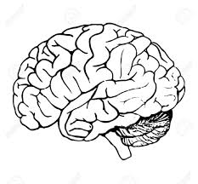
Motivation : Music
Main goal of music:
The music states should be the states of brain (corresponding part of it)
reward circuit

Slide 6
Motivation
What to do if number of states is too large?
Limit the model to small state number Doesn’t capture any long scale behaviour
Music example: Major / minor (‘Mood’ of music)
Restrict yourself to smaller number of topologies
Choose topologies randomly
Why should a random choice be good?
Do something else?...
Try my approach :)

Slide 7
Sketch of the idea
Bean the data (here we are “losing” information)
. . . x₀ x₁ x₂ x₃ x₄ x₅ x₆ x₇ x₈ x₉ x₁₀ x₁₁ x₁₂ x₁₃ x₁₄ x₁₅ . . .
Hope: behaviours inside causal states of first layer machine are similar and can be well described with an 𝜺-Machine
f
f
f
f
First layer
. . .
. . .
y₁
y₂
y₃
y₄
.
.

Slide 8
Stock market prices
Good arena:
Nice discrete sequence of discrete alphabet
Very large state space
If one manages to predict well - amazing consequences

Slide 9
Detour : Moral issues (perhaps unnecessary?)
Is stock market trading anything like being a parasite?
Make money on trading:
Buy when it’s cheap
Sell when it’s expensive
Results:
Smoother prices
Increased demand on goods when supply is high
Increased supply of goods when demand is high
Joseph

Slide 10
Specific implementation
Beaning function:
Binary
Down → 0
Up → 1
Ternary
Down enough → 0
Roughly same → 1
Up enough → 2
Use one half of price history to build the Layered 𝜺-Machines Use the other half to check how well it does

Slide 11
Checking how well L𝜺M does
Naive trading algorithm:
Start with $100
Bet every day
Use binary alphabet
Look at outgoing edges of the finest machine’s current state
Do not maximize daily income expectation
Bet amount proportional to difference of up and down probabilities

Slide 12
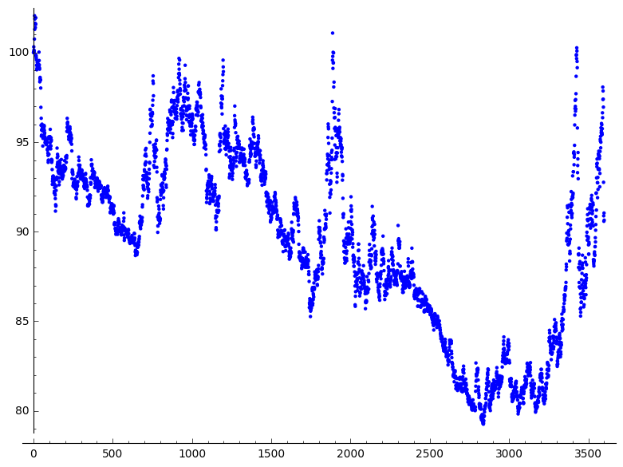
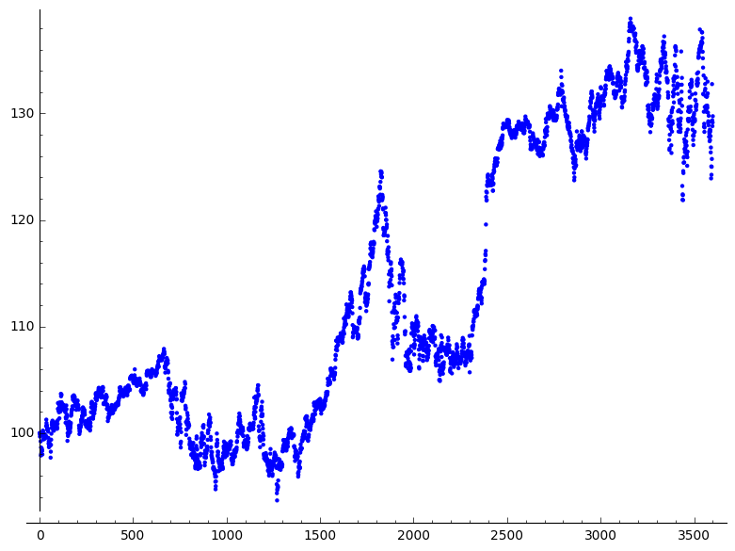
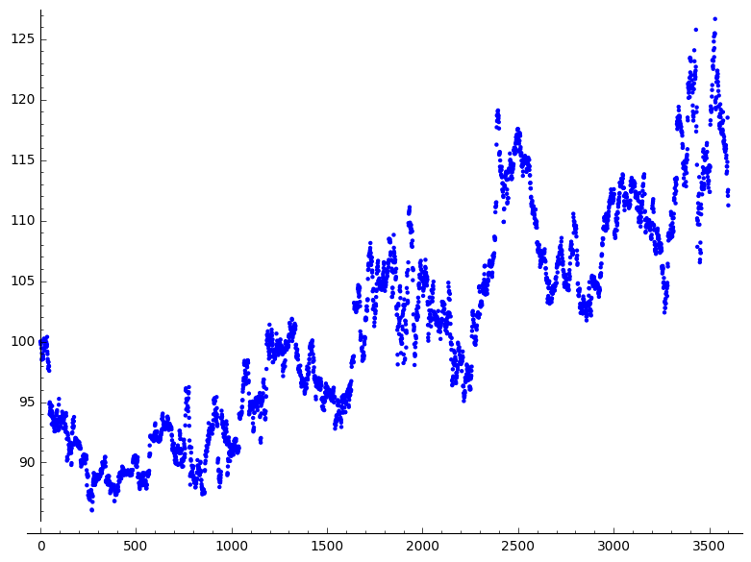
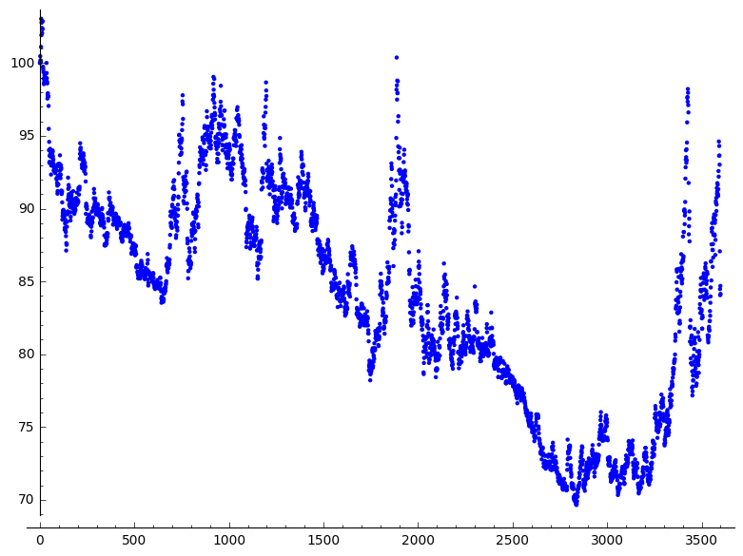
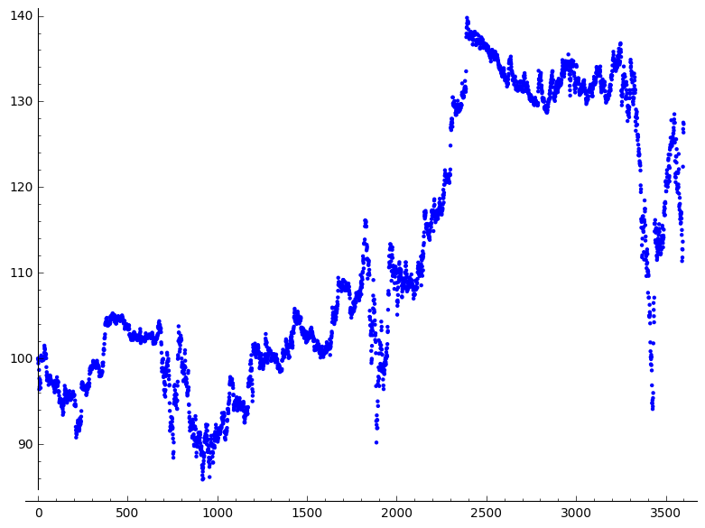
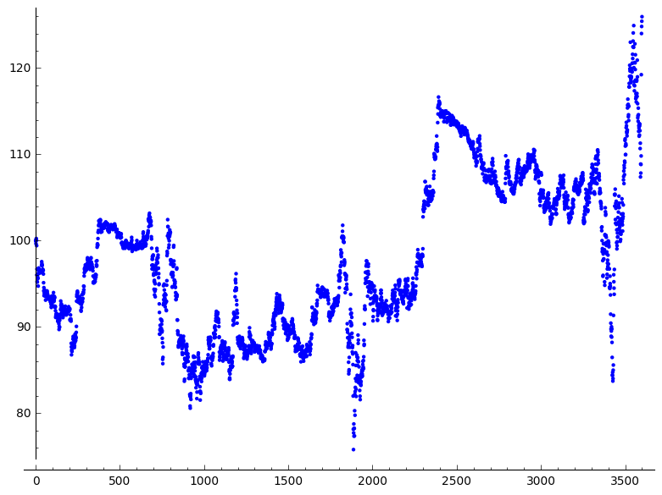
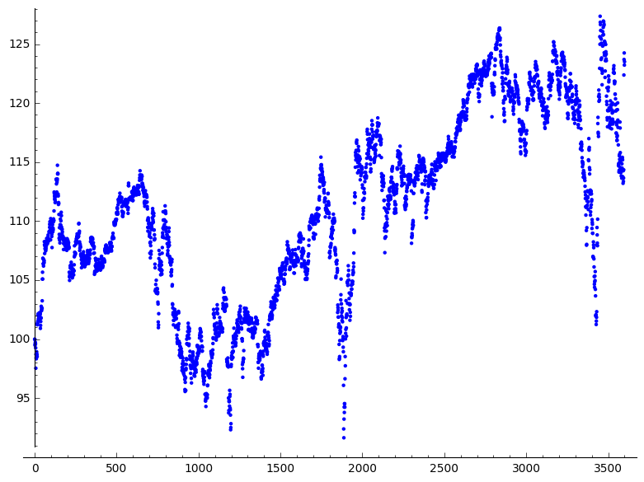
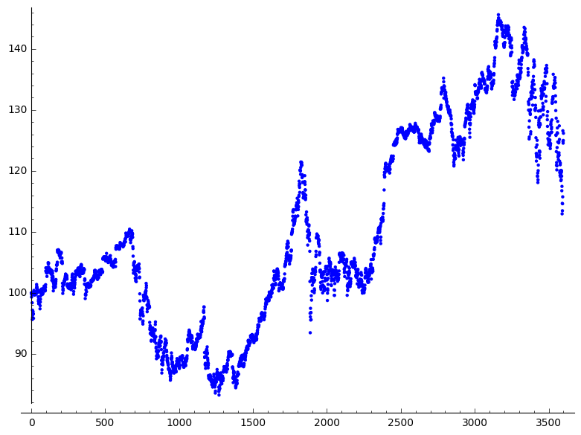
Preliminary results : trading silver
𝜺-Machine
2 states:
3 states:
4 states:
Layered 𝜺-Machine
[20, 1] [20, 1] 2 states 3 states
[200, 1] [200, 1] 2 states 3 states
[200,20,1] [200,20,1] 2 states 3 states
program
crushed

Slide 13
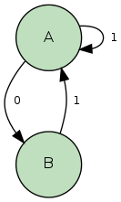
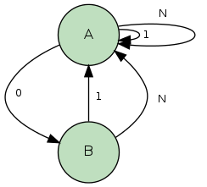
What needs to be done next
Problem:
Train EM with a lot of short sequences of data
Currently implemented solution:
Concatenate sequences
Better one:
Concatenate sequences with a special symbol sandwiched. This symbol brings any state to a start state

Slide 14
Summary
Potentially interesting questions
According to preliminary results LEM did better than EM
How to find nice beaning functions
Calculating the information quantities of layered 𝜺-Machines

